Slide 1

Cannabis Facility Design
(Week 1)
Instructor: Frank Altomare, NACPT Pharma College

Slide 2
Welcome to the Course
About The Instructor

Slide 3
Welcome to the Course
About You!

Slide 4
Course Outline
Course Outline
Expectation
Evaluation
  Participation/Attendance – 10%
  One exam – 50%
  One project – 20%
  One quiz – 20%

Slide 5
Facility Design
What are some different types of Cannabis Facilities?

Slide 6
Facility Design
Production Facility
  Packaging
  Processing and Packaging
  Cultivation, Processing and Packaging
  Greenhouses, Processing, and Packaging
  Outdoor Grow Operations
Micro-Cultivation / Nursery
Research and Development Laboratories
Specialty / Mix-Use Facilities

Slide 7
Production Facility
a) Packaging Only

Slide 8
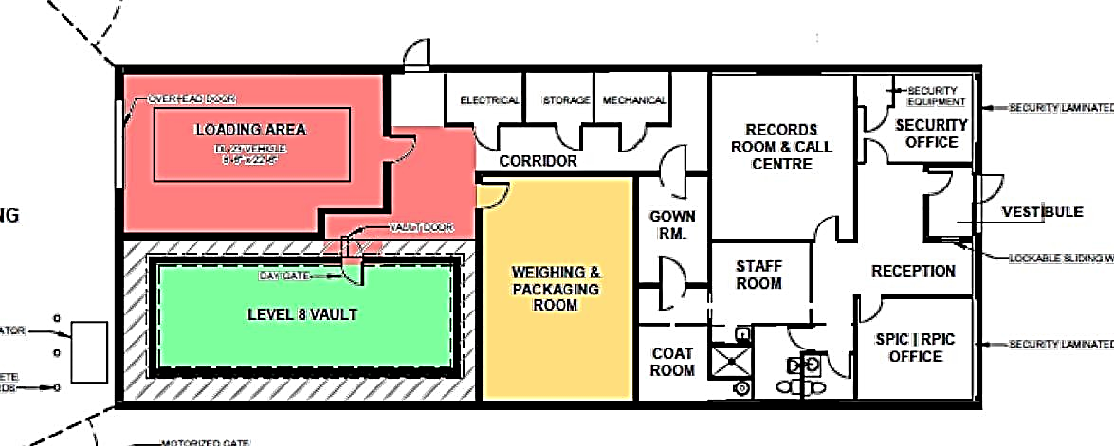

Slide 9
1. Production Facility
b) Packaging and Processing

Slide 10
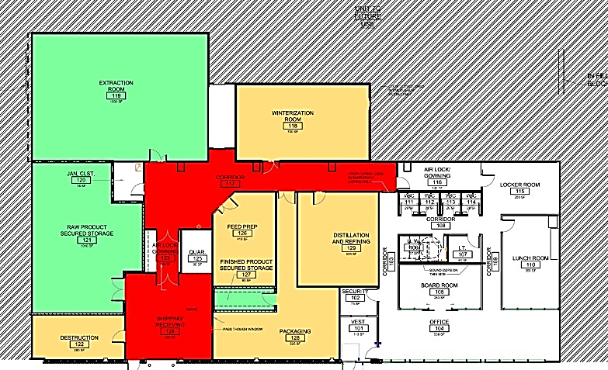

Slide 11
Production Facility
c) Cultivation, Processing, & Packaging

Slide 12
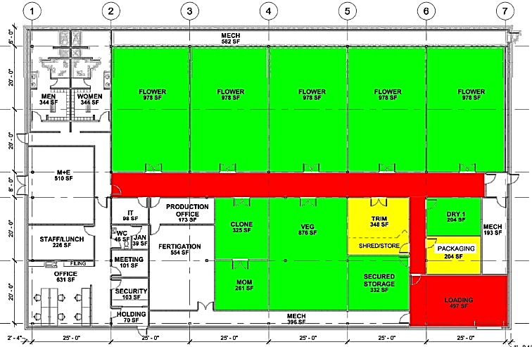

Slide 13
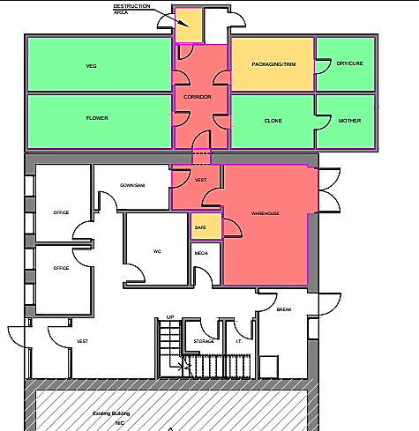

Slide 14
Production Facility
d) Greenhouse Cultivation, Processing, & Packaging

Slide 15
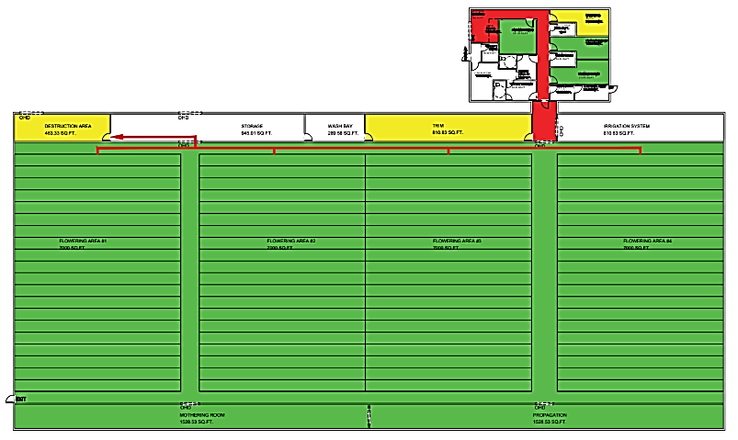

Slide 16
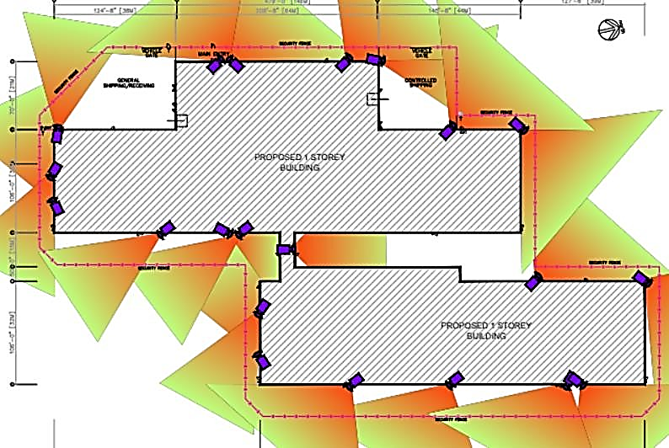

Slide 17
Production Facility
e) Outdoor Grow Areas, Cultivation, Processing, & Packaging

Slide 18
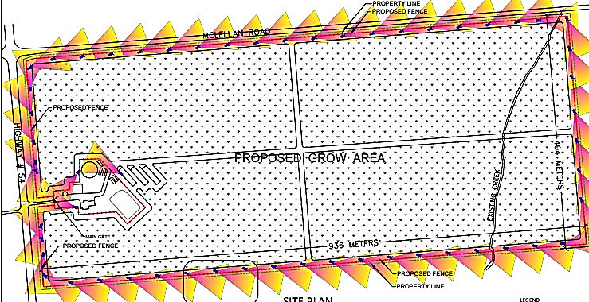
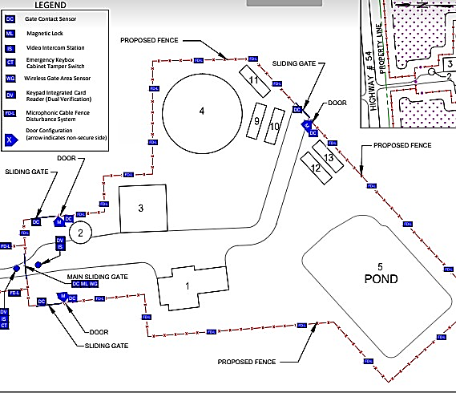

Slide 19
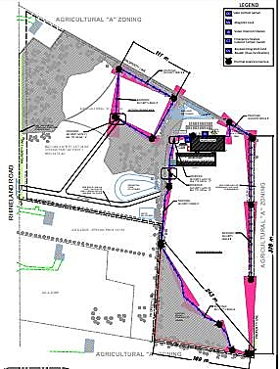

Slide 20
2. Micro-Cultivation/Nurseries

Slide 21
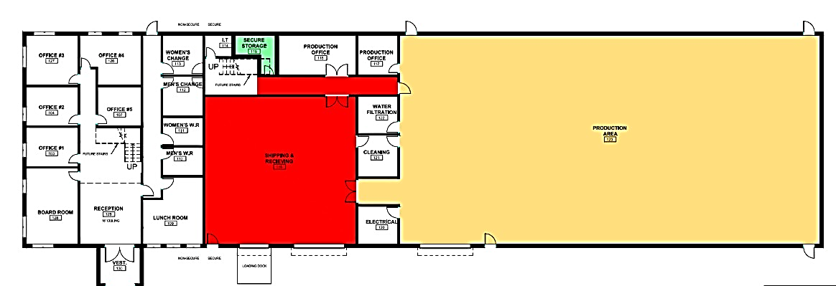

Slide 22
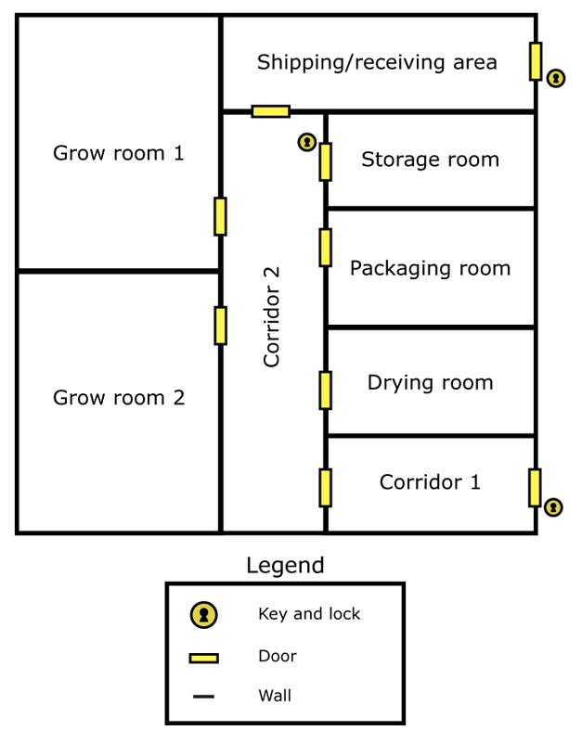
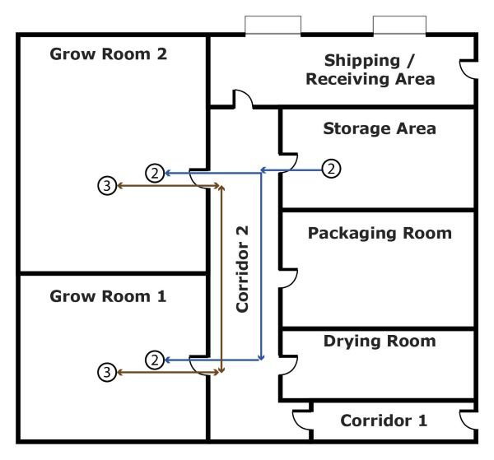

Slide 23
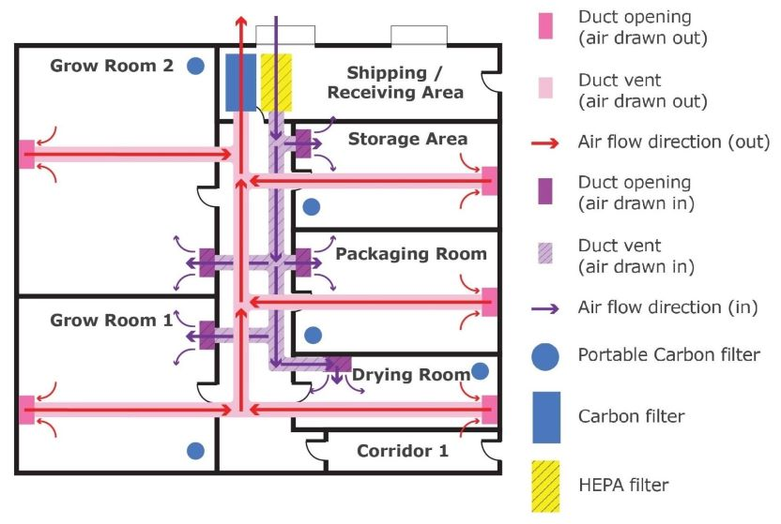

Slide 24
3. R&D Laboratories

Slide 25
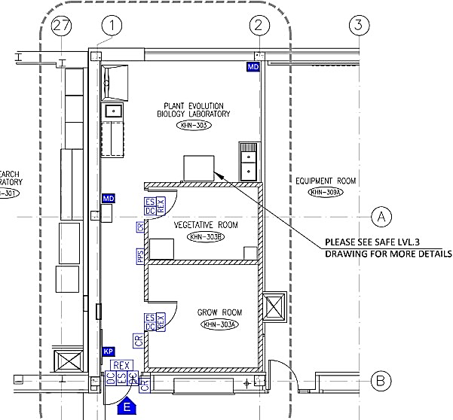

Slide 26
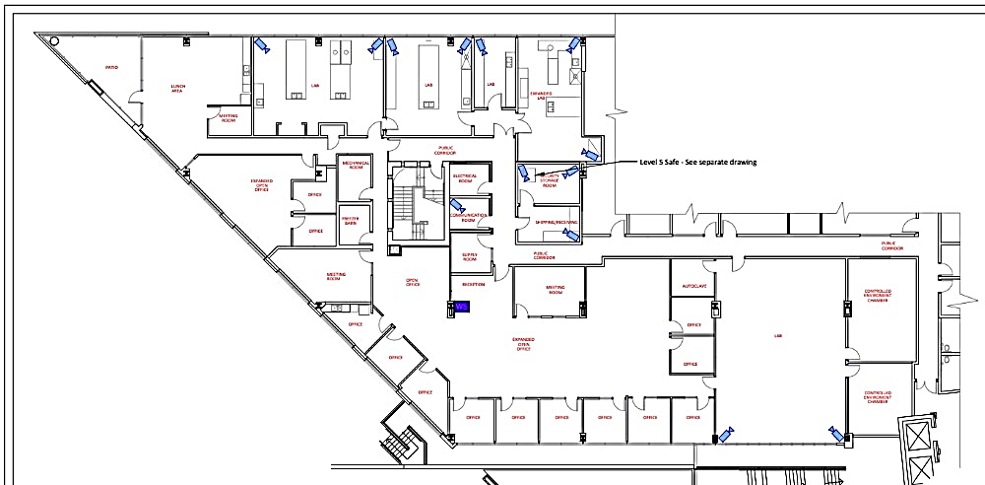

Slide 27
4. Specialty / Mix-Use Facilities

Slide 28
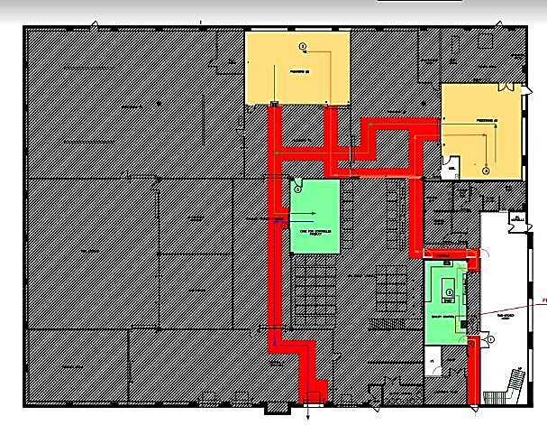

Slide 29
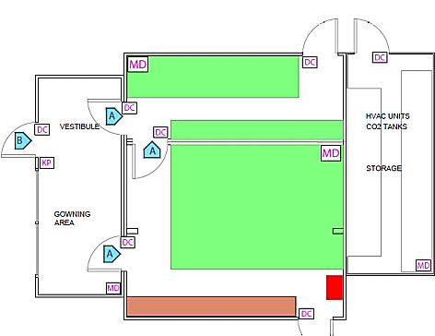

Slide 30
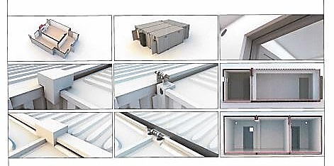

Slide 31
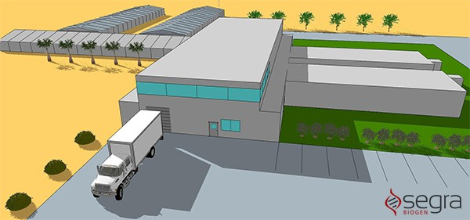

Slide 32
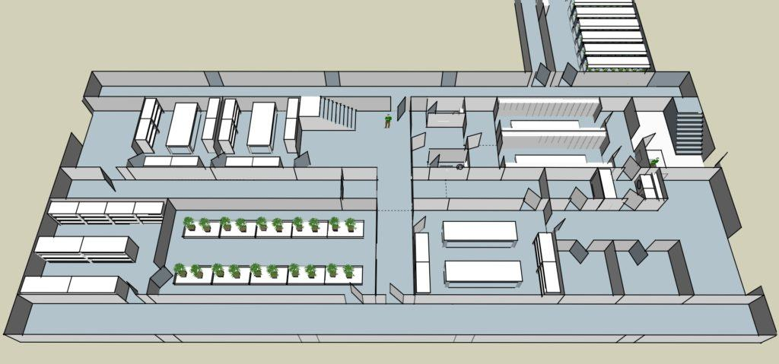

Slide 33
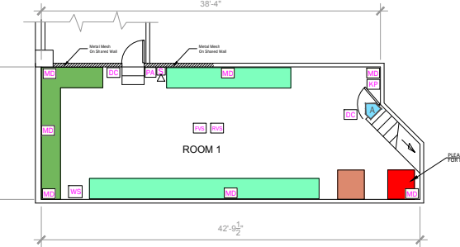
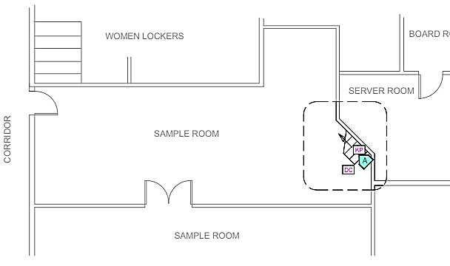

Slide 34
Cannabis Facility Design
(Week 2)

Slide 35
QUIZ
!

Slide 36
Facility Design
Exterior
Entry Points
Administrative Areas
Operational / Service Areas
Processing Areas
Cultivation

Slide 37
Facility Design
Exterior
Fences?
Shared Walls
Shared Roofs? (Olli Example)
Gates
Pedestrian Exit Doors
Pedestrian Entry Doors (are they needed?)
Will cannabis be carried outside? (Catalent Example – next page

Slide 38
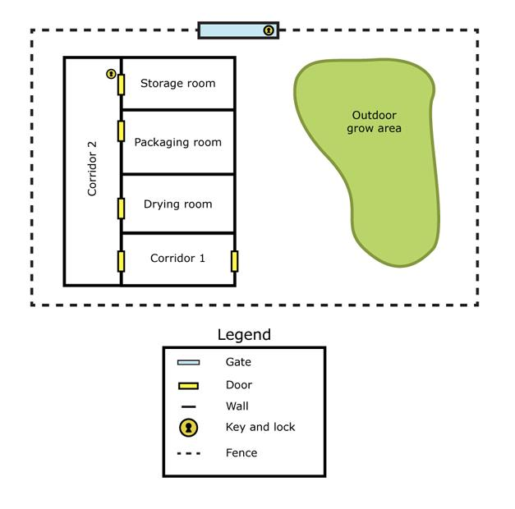

Slide 39
Facility Design
Entry Points
Well-Defined?
Is the loading dock shared with a neighbor?
Is there a natural progression from entry to a reception area? Why can’t we just enter the production area?

Slide 40
Facility Design
Administrative Areas
Are there administrative offices?
Are they logically positioned within the facility?
Is there a clear separation between office areas and production area?
Is there a secure file room?
Is there a secure sever / IT room?
Is there a security office?
Is there a lunchroom?
Are there changerooms, and are they only ways to access production?

Slide 41
Facility Design
Operational / Service Areas
Are there enough stairwells?
Are there dead spaces?
Is the maintenance / fertigation / electrical room big enough?
Can service areas be accessible from the outside without going through production areas?
Is there a plan for securing these areas?
Do second-floor stairwells lead into production areas allowing for bypass of the security system?
Are there building emergency exits?
Are there windows?

Slide 42
Facility Design
Processing Area
Are they large enough?
Will they be seasonally interchangeably-used? (Argotiva Example)
Is access to one processing area requires accessing another?
Are the doors to these areas wide enough to move material to & from?
Are processing areas located close to one another?
Is there a destruction room? What is the method of Destruction?
Is there a secure Storage room, and what is its construction method?

Slide 43
Facility Design
Cultivation Areas
Is the greenhouse adequately protected from the exterior? Is it enclosed by a fence?
Are outdoor grow areas accessible for vehicles?
Are outdoor grow areas fenced, with controlled access?

Slide 44
Cannabis Facility Design
(Week 3)

Slide 45
ASSIGNMENT - DESIGN YOUR CANNABIS FACILITY
This assignment must be submitted individually:
On a computer, or by using a pen and paper, create a detailed sketch of a proposed cannabis facility of your choice (LP, Micro, Greenhouse, etc.).
In your design you must consider:
  Product Flow
  People Flow
  Non-Cannabis Material Flow Parking
  Entry to the facility
  Quality Control practices and principles Restriction of Access
  Emergency Exits
  Critical business areas (washrooms, IT, Mechanical/Electrical, Reception, etc.)
You will need to provide a Floor Plan (Interior) and a Site Plan (Exterior)

Slide 46

Questions?

Slide 47
Thank you for your attention!

